Slide 1
Sales in Alpha
Current Status & Future Roadmap
Rachel Silvey, Priyanka Gupta
February 18, 2025

Slide 2
Overview of Sales Journey and planned improvements
Customer is enrolled in a mobility protection plan and calls Asurion for help
System determines the customer is eligible for a new product
Expert sees the eligible product(s)
(Compelling sales offer)
Expert handles the customers request (claim)
Expert pitches the new product to the customer
(Compelling sales offer & rebuttals)
Expert enrolls the customer in the new product
(Accept offer, Consent to enroll)
Expert is compensated for the sale
Customer is not happy with the product
(Saves Desk)
Expert creates rapport, breadcrumbs the offer, collects customer intel
Expert sees their real time sales data
(Real-time dashboard)
Near-term Priorities
Feature | Jan |  | Feb |  | Mar |  | Apr |  | May |  | Jun |  | Jul |  | Status | Benefit
Real-time leaderboards |  |  |  |  |  |  |  |  |  |  |  |  |  |  | Launched | Increase SP100
Compelling sales offer |  |  |  |  |  |  |  |  |  |  |  |  |  |  | In Progress | Increase SP100
Compelling rebuttals |  |  |  |  |  |  |  |  |  |  |  |  |  |  | In Progress | Increase SP100
FTC: consent to enroll |  |  |  |  |  |  |  |  |  |  |  |  |  |  | In Progress | Regulatory
Accept/Decline offer + Enroll |  |  |  |  |  |  |  |  |  |  |  |  |  |  | In Progress | Tech migration (ASP Decom)
Build
Pilot
Launch

Slide 3
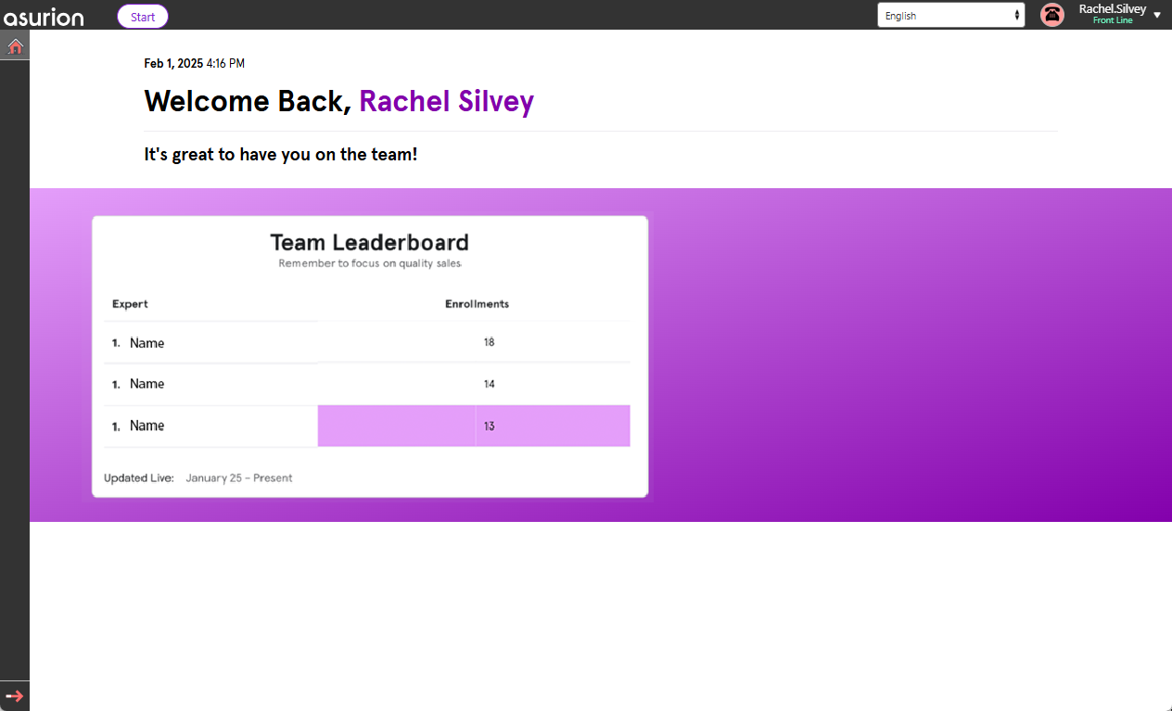

Real-time leaderboard
GOAL: Do no harm
Phase 1 LAUNCHED: Visible only on home screen
– accessible on demand by clicking on the home icon (toggle)
PILOT RESULTS (Vz)
 | SP100 |  | Accept Rate
Expert | Baseline 1/1 to 1/17 | Pilot 1/18 to 1/31 | Baseline 1/1 to 1/17 | Pilot 1/18 to 1/31 | Impact
1 | 10.5 | 6.3 | 19.6% | 16.7%
2 | 8.9 | 21.4 | 21.1% | 27.3%
3 | 12.9 | 18.2 | 22.2% | 32.5%
4 | 11.7 | 14.1 | 20.6% | 22.7%
FULL SCALE RESULTS (Vz)
 | SP100 |  | Accept Rate
#Experts | Baseline 1/25 to 2/3 | Results 2/4 to 2/12 | Baseline 1/25 to 2/3 | Results 2/4 to 2/12 | Impact
734 | 3.1 | 3.0 | 12.5% | 12.1%
Features:
Benefit: Gamification to increase SP100
Experts can compete against teammates within their same org structure
Based on weekly sales data
Real-time data from Enterprise APIs:
Org Chart API (WorkDay)
Analytics API (sales summary data)
FULL SCALE RESULTS (ATT)
 | SP100 |  | Accept Rate
#Experts | Baseline 1/25 to 2/3 | Results 2/12 to 2/17 | Baseline 1/25 to 2/3 | Results 2/12 to 2/17 | Impact
734 | 3.1 | 3.0 | 12.5% | 12.1%
FULL SCALE RESULTS (Cricket)
 | SP100 |  | Accept Rate
#Experts | Baseline 1/25 to 2/3 | Results 2/12 to 2/17 | Baseline 1/25 to 2/3 | Results 2/12 to 2/17 | Impact
734 | 3.1 | 3.0 | 12.5% | 12.1%
Phase 2: Persistent view Coming Soon!

Slide 4
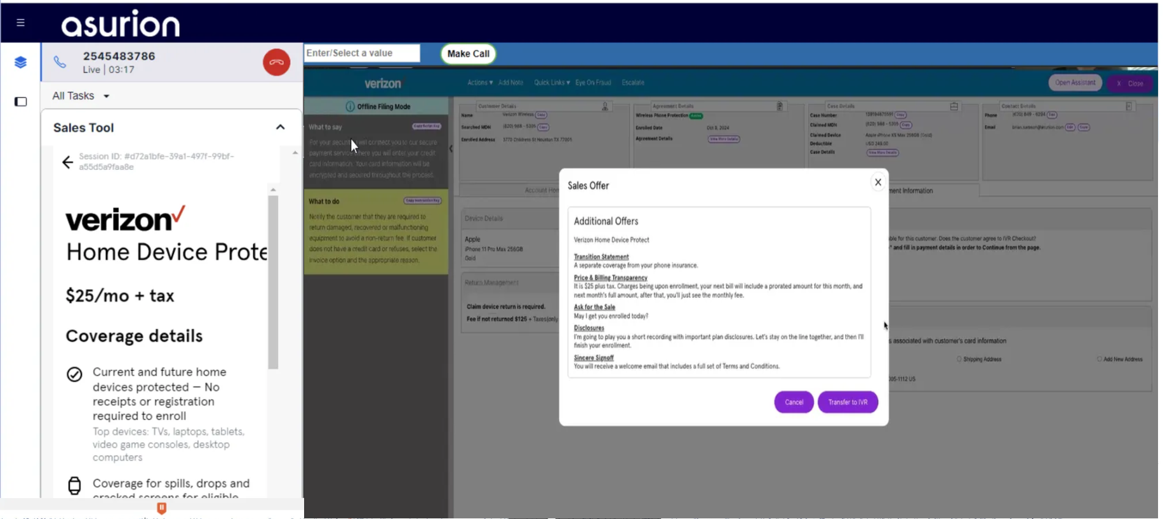
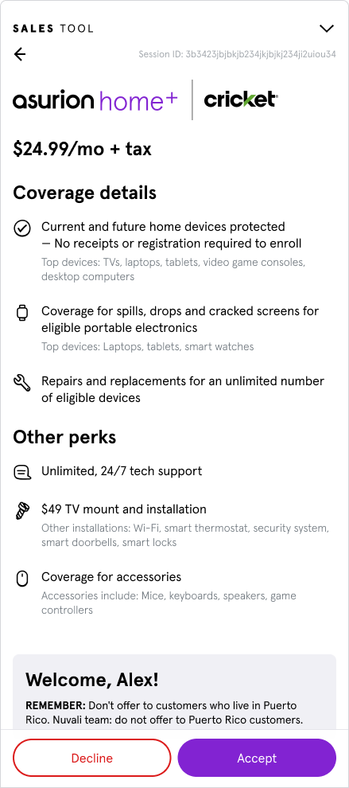
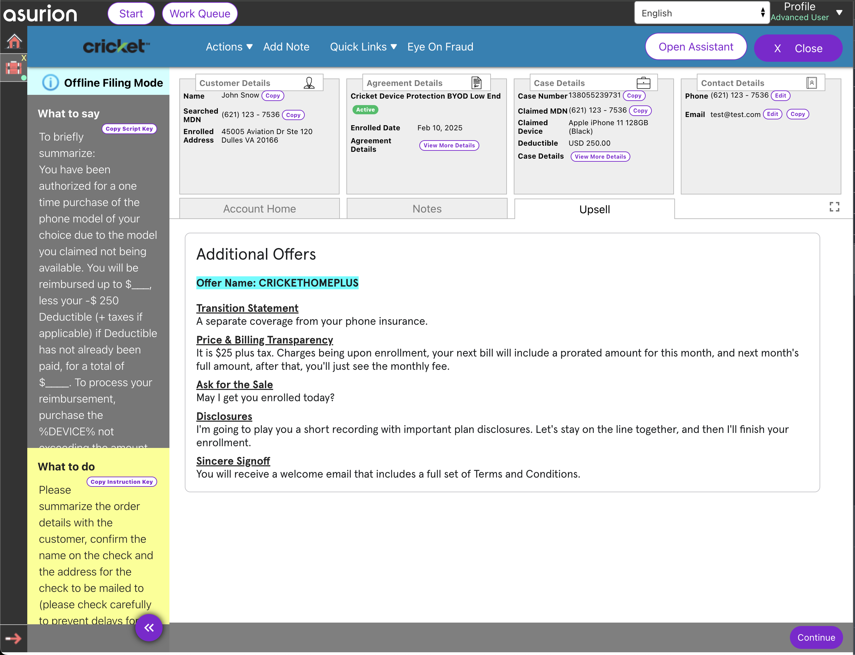
[Current] Sales Offer + Accept/Decline offer + Enroll
1
Static Coverage Details in ASP
2
1
Static Sales GPS scripting in Alpha to guide experts into a compliant sales offer
2

Slide 5
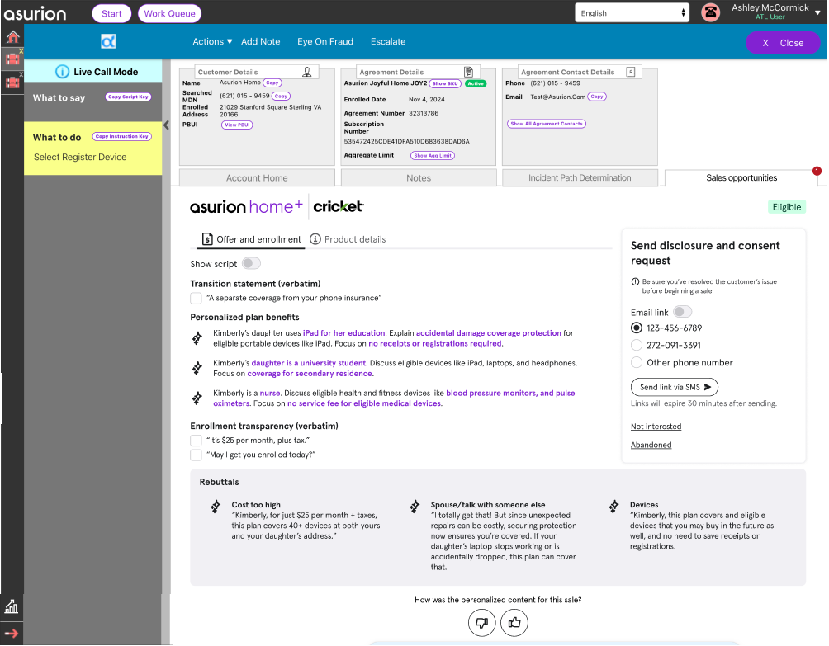
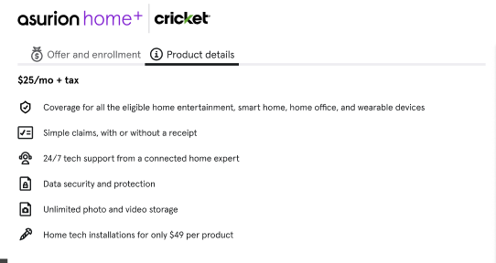
The landscape of where we’re headed for Sales in Protection
New Features for Sales
A
Key product details available in Alpha _{(vs ASP)} , use as needed (static content about specific program features)
A
B
Compelling & Personalized Gen AI sales offer _{(vs Static)} content will be available in Alpha to aide the expert in selling (Bullets & Script version available)
D
C
Quick Rebuttals for top reasons (cost, need more time, few devices) easily accessible and personalized
B
The ability to accept or decline an offer, and enroll customers will migrate from ASP to Alpha with the FTC project (April/May 2025)
D
C

Slide 6
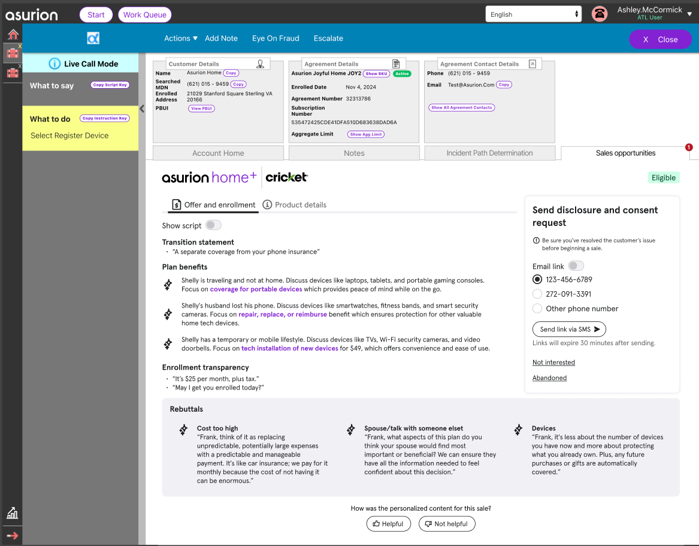
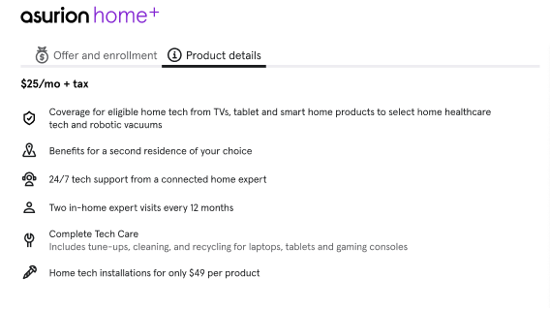
New sales features in Alpha will increase SP100
Components for Agent Sales
A
A
Key product details will be available in Alpha, use as needed (static content about specific program features)
B
Expansive sales offer content will be available in Alpha to aide the expert in selling
B
C
Rebuttal content easily accessible
D
The ability to accept or decline an offer, and enroll customers will migrate from ASP to Alpha with the FTC project (April/May 2025)
D
C

Slide 7
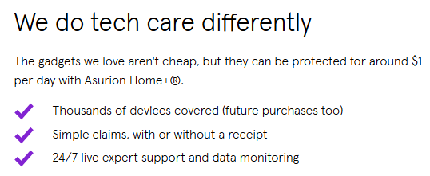
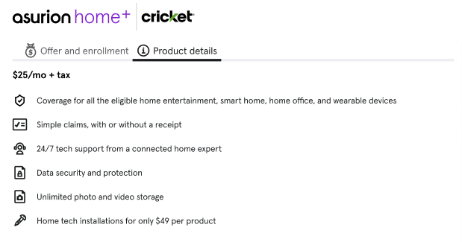
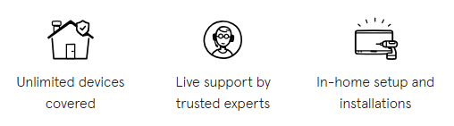

[A] A static list of product details are always available to answer expert/customer questions about the program
Key product details available in Alpha _{(vs ASP)} , available as needed (static content about specific program features)
Mirrors value prop content on a.com marketing page:
A

Slide 8
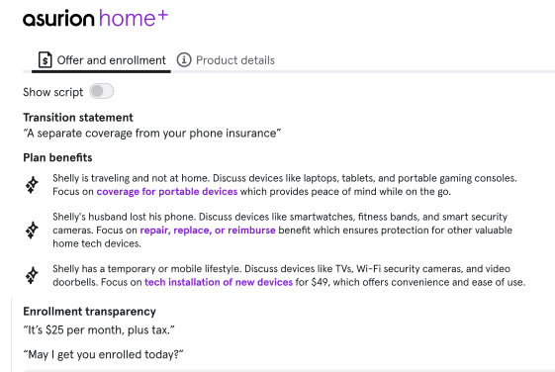
New sales features in Alpha will increase SP100
Components for Agent Sales
A
A
Key product details will be available in Alpha, use as needed (static content about specific program features)
B
Compelling & Personalized Gen AI sales offer _{(vs Static)} content will be available in Alpha to aide the expert in selling (Bullets & Script version available)
B
C
Rebuttal content easily accessible
D
D
The ability to accept or decline an offer, and enroll customers will migrate from ASP to Alpha with the FTC project (April/May 2025)
C

Slide 9
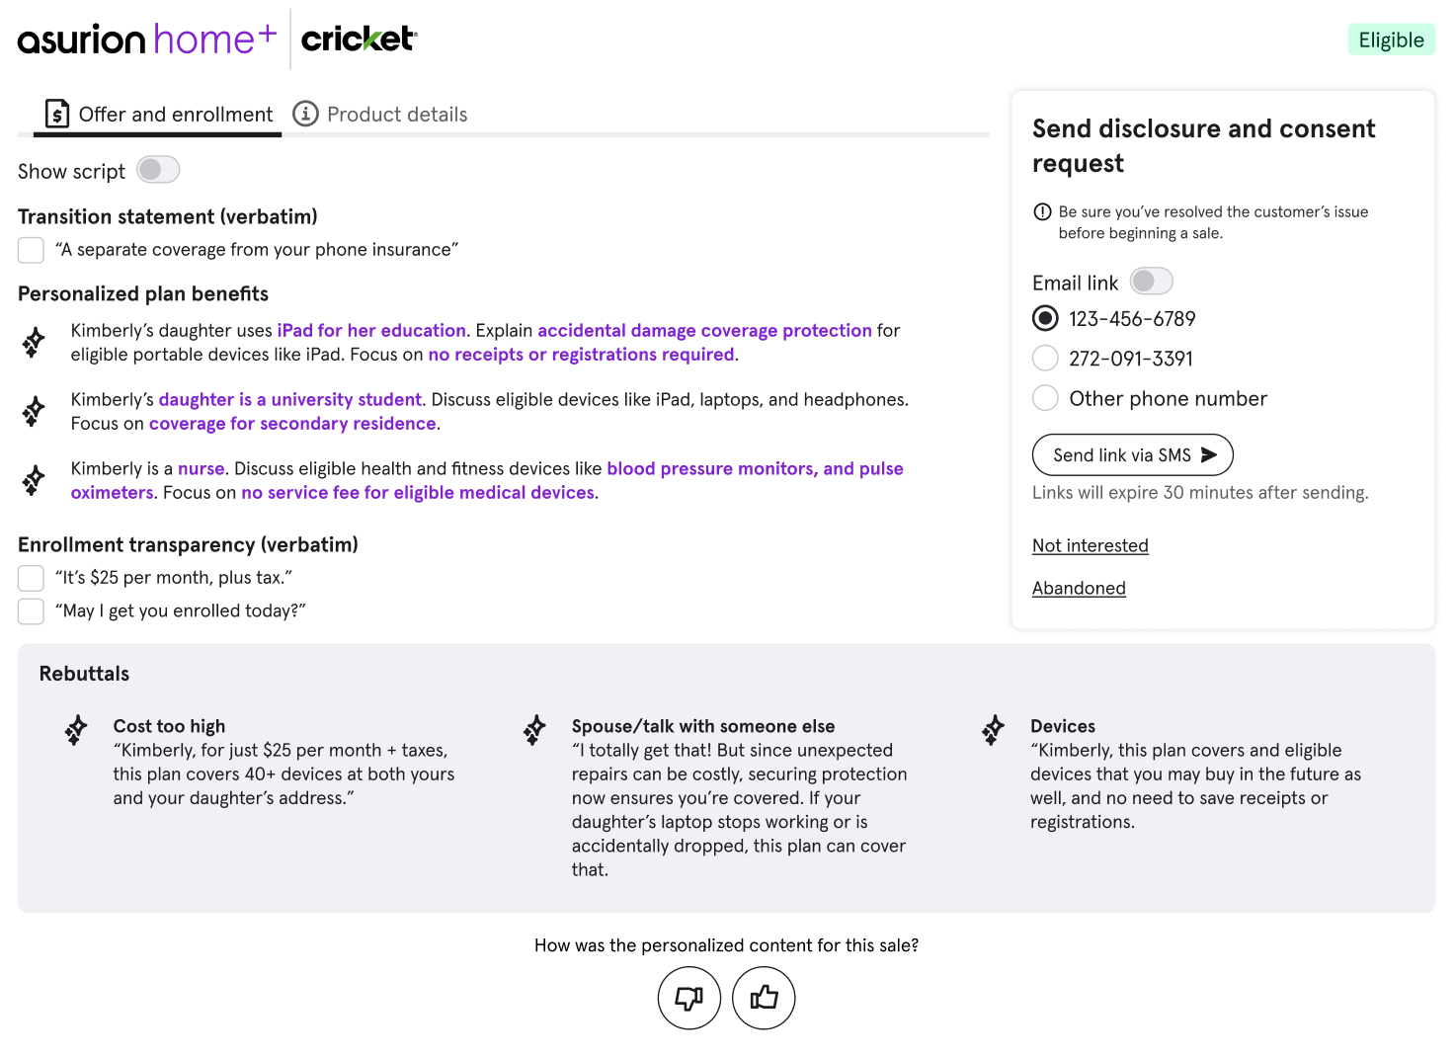
[B] Compelling & Personalized Gen AI sales offer
B
Compelling & Personalized Gen AI sales offer _{(vs Static)} content will be available in Alpha to aide the expert in selling (Bullets & Script version available)
Key Product Benefits
Repair, Replace, Reimburse
Accidental damage coverage for eligible portable devices
Future devices
49$ installations
Other
+
Key customer traits
**iPad Usage for Education**: The iPad is used by her daughter for school.
**Daughter at University**: Kimberly's daughter is attending University.
**Kimberly's Profession as a Nurse**: She may have health and fitness and health devices like pulse oximeters, blood pressure monitors etc.
B

Slide 10
[B] Quick Personalized Rebuttals
C
Rebuttal content easily accessible
Key Product Benefits
Repair, Replace, Reimburse
Accidental damage coverage for eligible portable devices
Future devices
49$ installations
Other
+
Key customer traits
**iPad Usage for Education**: The iPad is used by her daughter for school.
**Daughter at University**: Kimberly's daughter is attending University.
**Kimberly's Profession as a Nurse**: She may have health and fitness and health devices like pulse oximeters, blood pressure monitors etc.
C

Slide 11
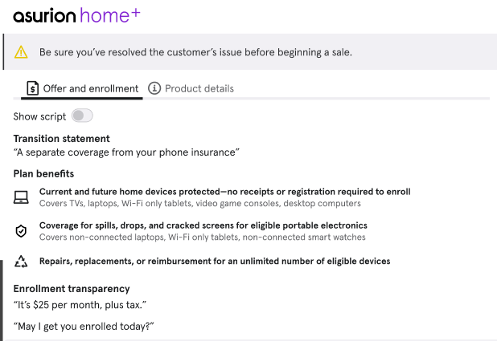
[Option B1(bullets)] Static sales offer prompt (if Gen AI offer is not available)
ASP - current
Alpha - recommendation
Static content in bullet form, same as ASP but prompted in Alpha in a guided flow
Transition statement
Top 3 plan benefits
Compliance statements
Product details available on demand (separate tab)

Slide 12
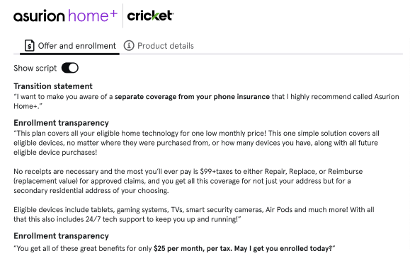
[Option B1(script)] Static sales offer prompt
ASP - current
Alpha - recommendation
Static content in full script form, prompted in Alpha in a guided flow
Transition statement
Top 3 plan benefits
Compliance statements
Product details available on demand (separate tab)

Slide 13
[Option B2] Moving beyond static content with GenAI personalized offer
Inputs
Engine
Outputs
Sales Eligibility
Derive a
Personalized,
Compelling & Sales Offer
Refine Sales Offer for Compliance/Sales GPS
Highly personalized Offer to this customer;
Prioritize top benefits;
Tailor to customer needs;
Clear value demonstration;
Fully compliant
Inputs from this call
Claim
_{1. Peril type}
_{2. Peril description}
_{3. Deductible}
_{4. Shipping vs Billing address}
Transcripts
_{1. Devices mentioned}
_{2. Other customer features}
Reasoning behind the recommendations
(why this offer is a good offer)
Previous claim and device upgrade history
Add and improve offer if experts needs it
Device detection from previous interactions
Bullets and/or Verbose
Claritas Customer Demographics
Tailored to Experts’ offering style
Experts’ Offering styles
Current
Future Iterations

Slide 14
[Option B2] GenAI model consumes active call transcript to identify key selling points, personalized for Shelly
**Traveling and Not at Home**: Shelly mentioned that they are traveling and not at home. This indicates that they might have valuable tech devices with them during travel, which could be at risk of accidental damage or loss. Highlighting Home+ coverage for portable devices like laptops and tablets can be appealing, as it provides peace of mind while on the go.
**Confusion About Plans**: Shelly seemed confused about the different protection plans and their costs. This presents an opportunity to clearly explain the benefits of VHDP, emphasizing its comprehensive coverage for a wide range of devices at a reasonable monthly cost, which can simplify her decision-making process.
**Interest in Device Protection**: Shelly expressed interest in protecting her phone, indicating a general concern for device protection. This concern can be extended to other devices in their household, making VHDP a logical choice for comprehensive coverage.
**Husband's Phone Lost**: The fact that Shelly's husband lost his phone suggests that they might be prone to misplacing or damaging devices. This can be used to emphasize the importance of having protection for other valuable home tech devices, which VHDP covers.
**Household Situation**: Shelly mentioned that they are staying at a specific address until Sunday, which implies they might have a temporary or mobile lifestyle. This can be used to highlight the convenience of VHDP's coverage for multiple devices without needing to register each one individually, providing flexibility and ease of use.
**Desire for Quick and Reliable Service**: Shelly was concerned about the timely delivery of the replacement phone, indicating a priority for quick and reliable service. VHDP offers 24/7 technical support and expedited repair or replacement services, which can be highlighted as a benefit to ensure she receives prompt assistance for any covered device issues.

Slide 15
[Option B2(bullets)] Static key words combined with GenAI personalization
ASP - current
Alpha - recommendation
GenAI personalized offer combined with key words (highlighted) from static content; in a guided flow
Transition statement (static)
Top 3 plan benefits, combination of GenAI personalization and static program benefits
Key program benefits highlighted to draw attention/importance
Compliance statements
Product details available on demand (separate tab)
Targeted use for tenured experts

Slide 16
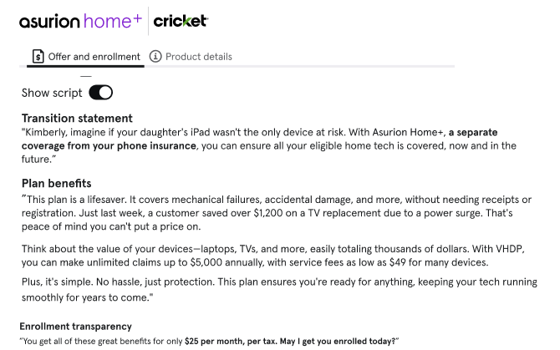
[Option B2(script)] Static key words combined with GenAI personalization
ASP - current
Alpha - recommendation
GenAI personalized offer with full script
Inclusive of transition statement, personalized benefits and compliance statements built-in
Product details available on demand (separate tab)
Targeted use for new experts

Slide 17
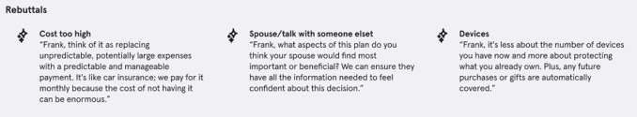
New sales features in Alpha will increase SP100
Components for Agent Sales
A
A
Key product details will be available in Alpha, use as needed (static content about specific program features)
B
Expansive sales offer content will be available in Alpha to aide the expert in selling
B
C
Rebuttal content easily accessible
D
The ability to accept or decline an offer, and enroll customers will migrate from ASP to Alpha with the FTC project (April/May 2025)
D
C

Slide 18
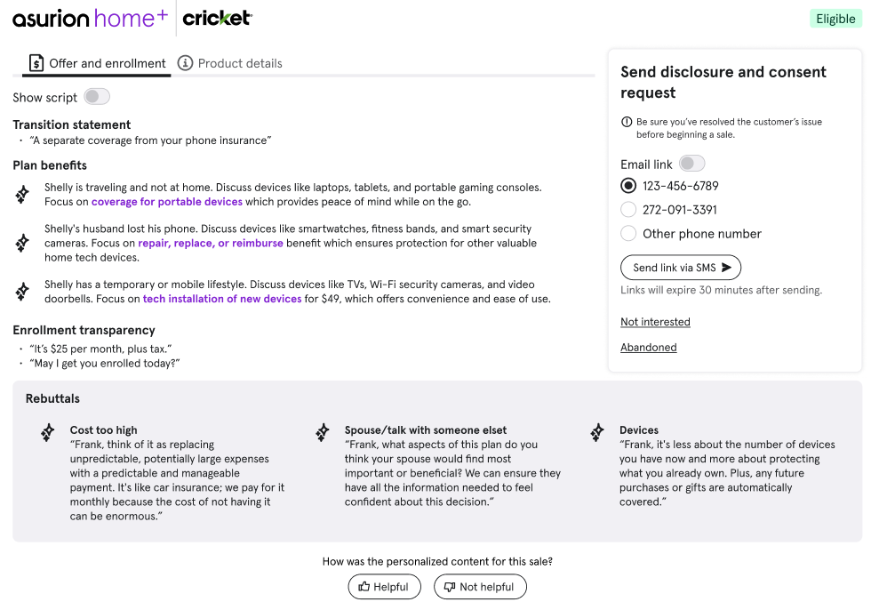

Compelling Rebuttals with GenAI personalization
Need new rebuttal content – use Shelly’s name
GenAI personalized rebuttals for 3 static categories
Cost
Spouse
Covered Devices
18

Slide 19
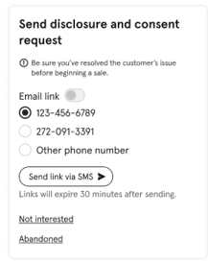
New sales features in Alpha will increase SP100
Components for Agent Sales
A
A
Key product details will be available in Alpha, use as needed (static content about specific program features)
B
Expansive sales offer content will be available in Alpha to aide the expert in selling
B
C
Rebuttal content easily accessible
D
The ability to accept or decline an offer, and enroll customers will migrate from ASP to Alpha with the FTC project (April/May 2025)
D
C

Slide 20
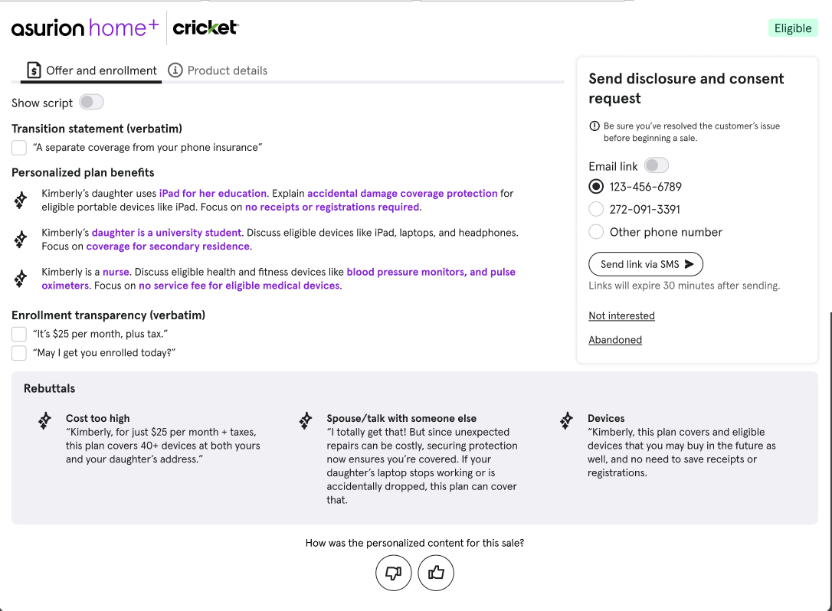
Customer consent to enroll added to new Sales Opportunities flow (FTC)
Mirror solution for Smart Pin / Pay By Link with refreshed UI design
Removing Recorded Disclosures
Need new rebuttal content – use Shelly’s name
20

Slide 21
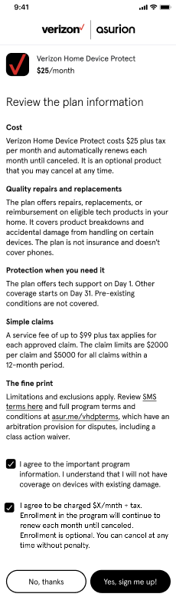
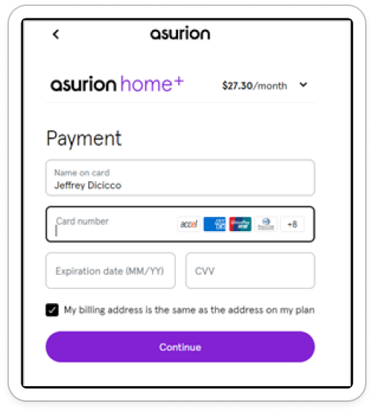
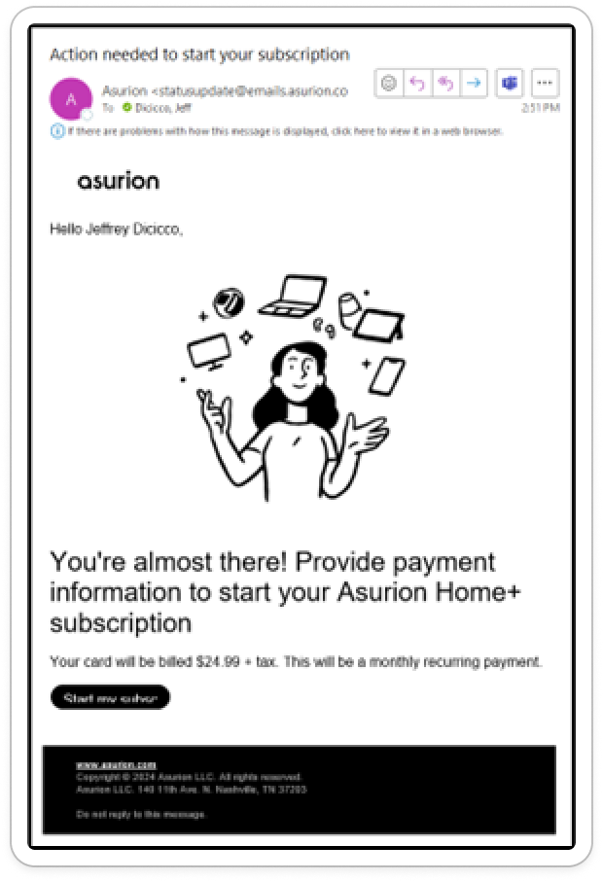
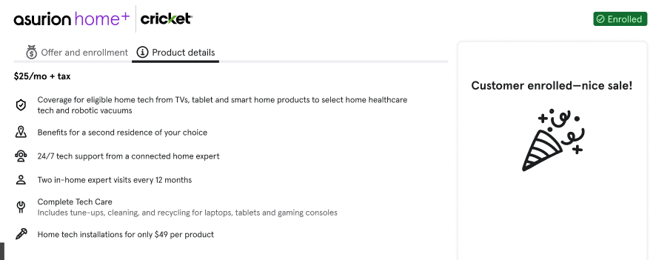
Customer journey for Alpha FTC Consent
Customer accepts offer
Expert sends the customer a Smart Link
Customer receives the link (SMS or email)
Customer provides consent to enroll
If Asurion billed, Customer provides payment for premium billing
Customer submits enrollment
Expert earns the sale
Enrollment Received
System matches consent to enrollment
Alpha – design in progress
Smart Link Payment TBD
Alpha Sale Complete
Comm – design TBD
Smart Link Consent TBD

Slide 22
Expert Feedback
Experts can provide feedback on the quality of the personalized offer to help train the model

Slide 23
Sales in Protection [Alpha] Priorities
Extended Priorities
Feature | Jan |  | Feb |  | Mar |  | Apr |  | May |  | Jun |  | Jul |  | Status | Benefit
Real-time leaderboards |  |  |  |  |  |  |  |  |  |  |  |  |  |  | Launched | Increase SP100
Compelling sales offer |  |  |  |  |  |  |  |  |  |  |  |  |  |  | In Progress | Increase SP100
Compelling rebuttals |  |  |  |  |  |  |  |  |  |  |  |  |  |  | In Progress | Increase SP100
FTC: consent to enroll |  |  |  |  |  |  |  |  |  |  |  |  |  |  | In Progress | Regulatory
Accept/Decline offer + Enroll |  |  |  |  |  |  |  |  |  |  |  |  |  |  | In Progress | Tech migration (ASP Decom)
Real-time pay dashboards |  |  |  |  |  |  |  |  |  |  |  |  |  |  | Discovery | Increase SP100
Saves Desk Cancel Reasons + commission reporting |  |  |  |  |  |  |  |  |  |  |  |  |  |  | Not Started | Decommission Sharepoint solution
Compelling rebuttals for Saves Desk |  |  |  |  |  |  |  |  |  |  |  |  |  |  | Not Started | Decrease churn
New Account Management UI (PBUI decom) |  |  |  |  |  |  |  |  |  |  |  |  |  |  | Not Started | Post Joyful Home
Call Wrap Notes Summary based on real time transcript |  |  |  |  |  |  |  |  |  |  |  |  |  |  | Discovery | Reduce after call worktime ~30secs
Sales Checklist – dependent on Call Wrap Summary |  |  |  |  |  |  |  |  |  |  |  |  |  |  | Discovery | Sales Compliance
Device Detection – dep on Call Wrap Summary |  |  |  |  |  |  |  |  |  |  |  |  |  |  | Discovery | Increase SP100
Replace ASP APIs with AM APIs |  |  |  |  |  |  |  |  |  |  |  |  |  |  | Slotted | Tech migration
Build
Pilot
Launch

